Slide 1
How to master accounting and tax concepts to gain commercial advantage
Presented by Mikaël Langlois

Slide 2
Agenda
Definition of accounting and taxation
Historical reminder of accounting and taxation
Differences between incorporation and business
Accounting and tax treatment of our products
The general concepts to know for the tax report production
The content of this presentation is provided for informational purposes only and does not substitute for legislative texts.

Slide 3
Definitions
Accounting: is a set of conventions and rules that consist of collecting and compiling data related to financial events and operations, in order to present, in a monetary unit, the financial situation and economic activities of an entity, allowing users of this information system to compare and analyze this accounting information and make decisions.
Taxation: is the fact that public administrations subject a legal or natural person to a tax, a fee, a contribution, or even a social security contribution.

Slide 4
Historical Reminder
1ST CTB
MANUAL
CONVERSATIO NAL LETTERING
ANTIQUITY
NOTION OF BALANCE
3000 BC
And no, I'm not talking about Josée-CLOSE
1494
Published by Luca Pacioli
16th century
1962
Birth
Daniel Vachon

Slide 5
The different accounting systems known over time
The organization of accounting has known 6 accounting systems
Italian accounting:
Luca Pacioli "The Father of Accounting" introduced double-entry accounting with the greatest concepts of ledger, journal entries, balance, profits and losses.
2.
The American journal:
This journal contained a significant number (about a dozen) of debit and credit columns. Due to its very practical usage technique, this journal found its place in the management of small businesses such as small artisanal enterprises. This type of accounting was often handled by students.
The stencil system or OBBO system:
A system that provided all accounting documents and entries through a single operation by superimposing documents, journals, and accounts. The stencil recording normally allowed avoiding carryovers and all the errors that could arise from them.
Mechanical accounting on front-loading accounting machines:
They were designed to print both the journals and the individual accounts of the various auxiliary accounts. The processing of general accounting in large companies was therefore exclusively reserved for front-loading accounting machines.
Computerized accounting:
In 1964, IBM launched in France the generation of computers from the 360 series. This allowed, among other things, to have account extracts, to see previous balances with amounts, movements in cash flow, and new balances.
Conversational accounting through computer lettering:
Gilbert Bitsch invented conversational lettering for qualifying entries for its application in general accounting and performed the first positioning of the details of third-party account balances on a computer.

Slide 6
Presentation plan
As accounting and taxation are extremely vast themes
and can be quite complex, I decided to focus my analysis on 3 axes directly related to our reality:
Incorporation and sole proprietorship
The major differences between the accounting and tax treatment of our various products
The general concepts to know for the production of tax reports
‘’Life is like accounting, even if it’s hard to be balanced, we still try to make it balanced no
matter what.‘’

Slide 7
INCORPORATION: Some advantages and disadvantages
ADVANTAGES DISADVANTAGES
#1
The classic tax advantage: Indeed, on the first $500,000 of your business, the tax rate is 19%.
Incorporation fees: These are legal fees and accounting fees. In addition to the one-time incorporation fees, there are annual fees for the preparation and filing of reports and documents.
#2
Capital injection: An investor is much more willing to put money into a corporation because they believe that the money will be used for the business and not to pay personal debts of the individual.
Government control: All corporations are required to produce documents and reports. These allow governments to exercise control and oversight over companies. Furthermore, the larger the corporation grows, the more it is scrutinized...
#3
Borrowing power of incorporated businesses: The corporation has its own assets and liabilities, and therefore has its own value. It is easier, or less difficult, for a corporation to borrow than for an individual, because, among other things, the personal debts of shareholders are not the debts of the corporation. The estates are separate.
Capital tax, FSS, and Training Act: The provincial government levies an annual tax on the value of the assets of corporations, which varies according to the activities of the concerned business. Additionally, contributions to the Health Service Fund are required, which can represent a significant amount. Moreover, if the payroll exceeds $250, 000.00, the company must allocate 1% of that payroll to training, under certain conditions.
#4
Guarantees: The corporation can give the entirety of its assets as collateral for a loan, whereas an individual or a company can do so more difficultly.
Business operation secrets: Generally, in a corporation, the "big secrets" must be shared. Thus, the more people who are aware of these so-called " big secrets," the more likely they are to be revealed.
#5
Subsidies: Many government subsidies are only offered to incorporated businesses.

Slide 8
Incorporation VS Registration
Summary Table
FACTORS | INCORPORATION | REGISTRATION
SalaryCos | Dividends|Salary+ | Net profits +|-
tWealth | 1000 | $40 Common
$Distinct
Entity | Distinct legal entity* | Net
Tax Rate | 19% ($500,000 EBIT) | 37% ($50,000 salary) * Combined marginal rate
*The creditor cannot pursue you personally IF you have not personally guaranteed the loan.

Slide 9
Myths
BEWARE OF MYTHS !!
MYTH #1: The corporate tax rate is lower, so it is automatically more advantageous to be incorporated!
It must be understood that the cash generated by a business will be taxed a second time when withdrawn/transferred to the shareholder. The combined taxes of the company and the shareholder are often equivalent to what a self-employed worker would have paid if they had received the money directly.
MYTH #2: There are more deductible expenses when incorporated!
The vast majority of expenses are deductible at the same level for the company as for the self- employed worker, except that a different mechanism is used.
EX.: Use of a car – The self-employed worker must deduct the personal portion of their vehicle expenses VS the shareholder using the company car for personal purposes will therefore be assigned a taxable benefit.

Slide 10
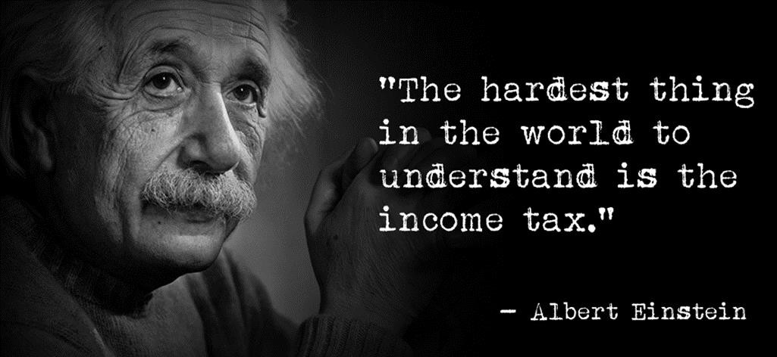
What to answer if a client asks whether they should incorporate?
Give the answer of a good "economist" with the famous: IT DEPENDS!!!
The incorporated company has many advantages. Nevertheless, each case is a different case. The advantages usually outweigh the disadvantages, but before making a decision, it is always best to check with a lawyer and an accountant to ensure the tax impact and other consequences of this mode of business operation.

Slide 11
The differences between the accounting and tax treatment of different products
PRODUCT - THE LEASE ACQUISITION
Leasing is a service that essentially allows the client to 'rent' equipment from HCC rather than acquiring it through a loan agreement.
The leasing contract is therefore a contract between two parties where one (the lessor, HCC) grants the other (the lessee, the client) the right to use equipment for a period of time in exchange for a consideration (the rent). Since it is a service, the lessee must pay the applicable taxes on said rent.
We usually find two main categories of leasing, namely the lease acquisition contract (which aims at the transfer of ownership of the equipment at the end of the term) as well as the operational lease contract (where the client has the option to return the equipment or purchase it at the end of the term).
Accounting treatment:
Appears on the asset side and is capitalized on the liability side of the balance sheet
The client records depreciation and interest as expenses in the income statement
Tax treatment:
1. The rent of the lease is recorded as an expense

Slide 12
The differences between the accounting and tax treatment of different products
PRODUCT - OPERATIONAL LEASE* COMMONLY CALLED THE SIMON JEAN PRODUCT*
What is OPERATIONAL LEASE?
Operational leasing is a contractual credit technique for the medium term by which a leasing company (the lessor) fully acquires, at the request and according to the specifications of its client (the lessee), the ownership of movable property for professional use, with a view to leasing it for a fixed term in exchange for fees or rents. The lessee, who maintains financial independence through this financing method, must take care of the asset as a good father of a family and insure it adequately.
Since the lessee does not intend to become the owner of the asset, the contract generally does not provide for a purchase option (e.g., FMV).
As a result, any potential buyback of the asset by the lessee is negotiated only at the end of the contract.
Operational leasing is most often offered by industry specialists, as it requires a good knowledge of the market.

Slide 13
The differences between the accounting and tax treatment of different products
4 criteria to qualify the off-balance sheet lease
ACCOUNTING TREATMENT TAX TREATMENT
#1
The term must be less than 75% of the
useful life of the asset
Since January 1, 2019, the new IFRS rules make it more difficult to treat leases as "off-balance sheet" for large companies that must comply with IFRS (international accounting standards).
N.B. Our lease may be classified with certain accountants as "off- balance sheet" if the structure meets the criteria, but we make no representation in this regard, clients must always validate with their external accountant. *See contract clause*
#2
The present value of the lease payments cannot exceed 90% of the fair market value of the asset.
Must be a lease contract of 12 months or less.
#3
No bargain purchase option
Our current lease allows for return, but in case of gains or losses upon resale, the difference will be the responsibility of the client or will be refunded to them.
#4
No automatic transfer of ownership at the
end of the term
Most of our clients do not apply the New IFRS rules, so this does not apply to them.
#5
No tax advantage to treat on-balance or off-balance, the real advantage is only the presentation of financial statements

Slide 14
The differences between the accounting and tax treatment of different products
PRODUCT – INSTALLMENT SALE CONTRACT
The installment sale contract is a loan contract aimed at facilitating the acquisition of equipment through a dealer.
It is used when a customer purchases equipment from a dealer duly authorized by HCC. It then acts as a loan contract and sales invoice. Therefore, the three parties must sign the contract (the customer, HCC, and the dealer).
From a legal point of view, the difference between this type of contract and a traditional sale is that the dealer retains ownership rights until full payment is made. HCC intervenes when it purchases the dealer's receivable.
Taxes are payable by the customer at the time of purchase or may sometimes be financed and reimbursable in the 3rd or 4th month.
Accounting and tax treatment:
Appears as an asset and as a liability on the customer's balance sheet. The customer depreciates the asset (depreciation) and the interest is recorded as an expense.

Slide 15
The differences between accounting and tax treatment of different products
Differences loans vs leases
Whether the client purchases the equipment or takes it on lease, it will affect their financial statements and tax return in all cases!
Purchase or lease, the effects will be different. However, the message to remember is the same: the financing of the equipment can have a significant impact on a company's net income.
The decision to purchase (CAPEX) or lease equipment involves several factors: the financing options available, the lowest overall cost when considering tax and discount rates, and the option most appropriate to the client's cash flow and tax situation.
It is therefore important to understand the impact that purchasing and leasing could have on financial statements and thus advise the client towards a decision regarding the financing product.

Slide 16
The differences between the accounting and tax treatment of different products
Differences loans vs leases
Here is now a numerical example with different scenarios to better understand the impacts on the financial statements.
BIGDAN VACHON EXCAVATION (1962) INC. buys an
excavator for $300,000 on a term of 60 months and wants information on the 3 possible financing options:
Option 1: Financing of the purchase | Option 2: Operating lease agreement | Option 3: Lease acquisition contract
Term: 5 years | Term: 5 years | Term: 5 years
Interest rate: 7.50% | Interest rate: 7.50% | Interest rate: 7.50%
Monthly payment: | Monthly payment: | Monthly payment:
$6011 | 4308$ | 6011$
 | Purchase option: 85,000$ | Purchase option: 1$

Slide 17
The differences between the accounting and tax treatment of different products
Differences loans vs leases
Option 1: Financing the purchase
Accounting: If the client buys the excavator, they will have control over it and it will appear as an asset on their company's balance sheet. The depreciation of the excavator will occur over its useful life and the annual depreciation (reduction in value) of the asset will be deducted from income. Five years would represent a depreciation rate of 20%. The funds borrowed for the purchase of the asset will be recorded as a liability. Throughout the year, the principal portion of the loan payments will be deducted from the liability, and only the interest portion, an expense, will be deducted from operating income.
Taxes: As in accounting, an asset will be recorded and the associated depreciation deduction (DPA) will apply to taxable income. For accounting purposes, the deduction on income will be calculated over the estimated useful life of the equipment. For income tax purposes, the CRA specifies the applicable deduction rate for the type of asset. In this case, the rate would be 30%. As in accounting, loan repayments are not deductible. However, the interest paid is deducted from the taxable income of the period.

Slide 18
The differences between the accounting and tax treatment of different products
Differences loans vs leases
Option 2: Operating lease agreement
Accounting: Equipment financing through a lease generally results for the leasing company in the recovery of the cost of the equipment and the realization of a profit. This results in a reasonably high monthly financial commitment for the use of the asset. Not being considered under the control of the client, the leased asset will not appear on its balance sheet and no liability will be recorded. Since it will not account for the ownership of the equipment, its financial statements will show neither depreciation expenses nor the interest portion of the payments to the leasing company. However, they will show the full amount of lease payments, which will be deducted from the income calculation.
Taxes: For tax purposes, no asset will be recorded and no CCA will be deducted. Unlike the purchase option, under which only the interest is deducted from income, the total amount of lease payments is deducted for tax purposes. However, it all depends on whether the client exercises their option by paying or refinancing.

Slide 19
The differences between the accounting and tax treatment of different products
Differences loans vs leases
Option 3: Lease-to-own contract
Accounting: Regarding the lease-to-own, the client will be deemed to have assumed the benefits and obligations related to the ownership of the excavator during the lease term. This assessment will be based on the lease term, the total lease payments, the purchase price at the end, and the automatic or non- transfer of ownership at the end. Consequently, the leased excavator and the liability to be repaid over the lease term will be recorded on the balance sheet. The control of the equipment being presumed, its depreciation will be accounted for in the case of a lease-to-own contract, as if it were a purchase. Unlike what happens in the case of an operating lease, the payments of the lease-to-own contract are treated as loan repayments - only the interest portion of the payments is charged as expenses.
Taxes: Even though the excavator appears on the balance sheet for accounting purposes, no CCA will be calculated for tax purposes. However, as in the case of an operating lease, the full amount of the lease payments is deductible for tax purposes (interest and principal).

Slide 20



SUMMARY (5-year term completed):
 | Purchase | Operating lease | Lease-acquisition
BALANCE SHEET
ASSET
Equipment | $300,000 | - | 300 000$
Accumulated depreciation (1) | (189 408$) | - | (189 408$)
LIABILITIES
Debt | (300 000$) | - | (300 000$)
Capital repayment | 300 000$ | - | 300 000$
Increase in net assets | 110 592$ | - | 110 592$
STATEMENT OF RESULTS
Interest expenses | 60 683$ | - | 60,683$
Depreciation (1) | 189 408$ | - | 189,408$
Lease payment | - | 258,490$ | -
Added operating expenses | 250 091$ | 258,490$ | 250 091$
DEDUCTIONS FOR TAX PURPOSES
Depreciation deduction (1) | 238,775$ | - | -
Interest charges | 60,693$ | - | -
Lease rent | - | 258 490$ | 360 683$
Total deductions | 299 458$ | 258 490$ | 360 683$
Operating expenses and tax deductions are based on the duration of the lease and have not been taken into account.
(1) The depreciation is 20% per year for
accounting purposes, while the deductions allowed for tax purposes are 30%.

Slide 21
The differences between accounting and tax treatment of different products
Comparative table of financial products
Factors | Loan | Lease-acquisition | Location-exploitation
Property | Immediate | Lease with option to purchase at the end of the | Lease with option to purchase at the end of the lease
Capital accumulation | Faster | lease Slower | None
Tax depreciation | Client | Client | HCC
Payment | Higher | Lower | The lowest
Purchase option | N/A | Bargain | JVM
Personal property taxes | Payment by the client and varies by state | Payment by the client and varies by state | HCC pays and the customer receives an invoice
Additional information | -Client's property with depreciation. -Immediate capital with a down payment or an exchange. | -A purchase option a bargain reduces the payment.-The customer can absorb the depreciation.- Capital accumulation is slow. -Features of a loan with lower payments than a lease. | -Optional use or ownership. -The customer treats the unit as a lease. -No capital accumulation.

Slide 22





Myths
BEWARE OF MYTHS !!
MYTH #1: Your monthly rents are seen as an expense.
The payments of the lease-to-own contract are treated like loan repayments at the accounting level. However, the difference will be at the tax level in terms of tax depreciation. Make sure to tell the truth to your client!
MYTH #2: The operating lease is more advantageous for tax purposes.
False: As we saw above, tax deductions are much lower than in the case of a lease-to-own and a loan.
Advantages of operating lease: 1-Faster equipment change 2-Off-balance sheet qualification
3-Compliance with certain financial ratios 4-Smaller rent
5-Absence of residual risk at the end of the lease

Slide 23






Questions about the product concepts we just covered?
There are only 2 times in life – NOW OR IT’S TOO LATE !

Slide 24
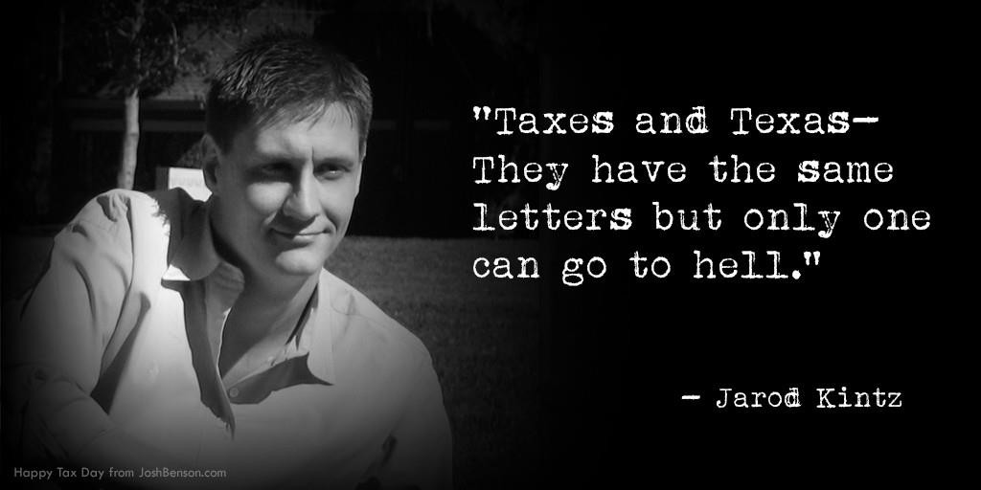
Tax management
GST-HST and QST
The obligations of businesses in terms of tax collection
Calculation of tax credits on inputs and refunds (ITC and RTC)
Production and declaration of GST and QST

Slide 25
Tax management
The Goods and Services Tax (GST and HST):
The Goods and Services Tax or GST (taxe sur les produits et services in French) is a multi- level sales tax introduced in Canada in 1991 by Prime Minister Brian Mulroney. The introduction of this tax was extremely controversial and was one of the determining factors in the largest electoral defeat of a federal party in power in the entire history of Canada.
It is a charge of 5% on the sale of any product or service, with the exception of certain essential items such as food, residential rent, medical services, and certain other services.
The Harmonized Sales Tax (HST) combines the Goods and Services Tax (GST) and the Provincial Sales Tax (PST) in participating provinces. It applies to taxable supplies and follows the same rules as the Goods and Services Tax, but in the following provinces:
Prince Edward Island - New Brunswick - Nova Scotia - Ontario - Newfoundland and Labrador.

Slide 26
Tax management
There are two categories of items, services, or products that are not taxed in Canada: Zero- rated and exempt sales.
Zero-rated sales: Certain products and services are subject to GST/HST at a rate of
0% (zero-rated). This means that no GST/HST is charged on the sale or supply of these products and services, and the seller/service provider can recover any tax they would have paid on their inputs.
Basic food products such as milk, bread, and vegetables;
Agricultural products such as grains, raw wool;
Most farm animals and most fish products such as fish intended for human consumption;
Prescription medications and prescription preparation fees;
Medical devices such as hearing aids and dentures;
Exports;
Several transportation services when the point of origin or destination is outside of Canada;
All supplies of products and services reserved for the use of the Governor General.

Slide 27
Tax management
There are two categories of items, services, or products that are not taxed in Canada: exempt sales and zero-rated sales.
Exempt sales: Certain products and services are not subject to GST/HST (exempt). This means that no GST/HST is charged on the sale or supply of these products and services, and the seller/service provider cannot recover the tax they pay on their inputs.
Residential properties that are not new;
Rent paid for long-term housing (one month or more) and condominium housing fees;
Certain sales of vacant land or agricultural land;
Most health services and medical and dental services that are provided for medical reasons by licensed physicians or dentists;
Child care services
Tolls for bridges, roads, and ferries (the toll for ferries is zero-rated if the ferry is coming from or going to a location outside of Canada);
Legal aid services;
Most educational services, such as courses provided by a professional institution

Slide 28
Tax management
Quebec Sales Tax (QST):
The Quebec sales tax (abbreviated as QST) is the tax on the sale of products and services collected by the Government of Quebec. The QST was introduced by the Liberal government of Robert Bourassa on July 1, 1992, and established amidst controversy. The Minister of Revenue at the time, Yves Séguin, resigned in protest against the adoption of this tax.
It is a charge of 9.975% on the price excluding the GST collected in Quebec during the supply of most goods and services.

Slide 29
Tax management
What are the obligations of businesses in terms of tax collection?
Register your business for GST and QST
Collect taxes from your customers
Calculate your input tax credits and input tax refunds
File your GST and QST returns for each reporting period.

Slide 30
Tax management
1- WHO MUST REGISTER FOR GST/HST AND QST FILES?
Generally, any business must register for the GST and QST files if it carries out commercial activities in Quebec. More specifically, it must register for the GST and QST files and collect these taxes if it is in one of the following situations:
The total taxable supplies (including sales, rentals, exchanges, transfers, bartering, etc.) made worldwide as well as those of the partners exceed $30,000 during a given calendar quarter or for the entire preceding four calendar quarters;
Someone operates a taxi or limousine business;
The customer does not reside in Quebec (or Canada, for the application of the GST), and you collect entry fees directly from the public for activities or events taking place in Quebec (or Canada, for the application of the GST).
EXCLUSIONS: Individuals, personal trusts, and partnerships where all partners are individuals cannot register for the GST file or the QST file if they are in one of the following situations:
They operate a business with no reasonable expectation of profit;
They offer products and services that are exempt from taxes.

Slide 31
Tax management
2- THE COLLECTION OF TAXES
As a registrant, each business is required to collect GST and QST when it makes taxable supplies (excluding exempt supplies). The business has the same obligation for HST when it makes taxable supplies (excluding exempt supplies) in participating provinces.
In addition, as a supplier of a taxable good or service, it must charge, collect, and remit any tax collected.
When should taxes be collected?
On the day a sum of money is paid
On the day a sum of money is due.
For HCC, as a lessor of goods, taxes are due no later than the date the tenant is required to pay rent, according to the written contract.

Slide 32
Tax management
3- ITC and RTC
By being registered for taxes, businesses can generally recover the GST and QST that have been paid (or to be paid) on the goods and services to which these taxes apply. The GST will be refunded in the form of an input tax credit (ITC), and the QST in the form of a refund of the input tax (RTC).
Inputs refer to the goods or services used or consumed in the course of the business activities of the company.
To be entitled to ITCs and RTCs for taxable goods or services acquired in the course of the business activities of the company, it must be registered during the reporting period in which it must pay these taxes.

Slide 33
Tax management
3- CTI and RTI
What are the eligible expenses for CTI and RTI?
Eligible expenses that qualify for a input tax credit (CTI) and a refund of the input tax (RTI) are, in general, those incurred to acquire taxable goods or services that are used or consumed in the course of the business activities of the company.
Office furniture;
Computer systems;
Accountant fees;
Machine repair costs;
Promotional items;
Tools.

Slide 34
Tax management
3- CTI and RTI
What are the exclusions for CTI and RTI?
Exempt supplies do not give the right to claim input tax credits (CTI) or input tax refunds (RTI).
The following items also do not qualify for CTI or RTI, as GST and QST do not apply to them:
Salaries;
Interest and dividends;
Insurance premiums;
Municipal, provincial taxes (other than QST), and federal taxes (other than GST);
Most fees, fines, and contributions.
Similarly, one cannot request CTI or RTI for goods and services acquired for personal purposes.

Slide 35
Tax management
3- CTI and RTI
How do we calculate CTI and RTI?
First, calculate the total of your taxable purchases (excluding tax-exempt purchases) for which you are entitled to an RTI under the QST system. Multiply the result obtained by 9.975/109.975. You will obtain the amount of your RTI for the relevant period.
Next, calculate the total of your taxable purchases (excluding tax-exempt purchases) for which you are entitled to a CTI under the GST system. Subtract the amount of the RTI from it. Multiply the result obtained by 5/105. You will obtain the amount of your CTI for the relevant period.
HCC is subject to the restrictions of large enterprises! We use the simplified method for certain expenses and for others the calculation is much more complex.
HCC and CLE do not have the same rules since we have more income from LOANS in HCC with EBR, Floorplan, ABL than in CLE. The concept of CTI and RTI is therefore not the same.

Slide 36
Tax management
3- CTI and RTI
How are CTI and RTI calculated using the simplified method?
A business incurs the following expenses during a fiscal year. All expenses are taxable, except wages and interest.
The ITR and ITC are calculated as follows:
• ITR = $920.21 × 9.975 / 109.975 = $83.47
• ITC = ($920.21 − $83.47) × 5 / 105 = $39.84
Wages = $200
Inventory = $345.08
Rent= $230.05
Office Supplies = $115.03
Interest = $50.00
Office Furniture= $230.05
Total expenses = $1 170.21
Total Taxable Expenses = $920.21
Wages and interest = $250.00 ($200+$50)

Slide 37
Tax management
4- Production of the GST and QST declaration (Calculation of the net tax)
You are ready to fill out your GST and QST declaration after calculating:
The GST and QST that you have collected as well as those that are owed to you, that is, the taxes that you have charged but have not been paid during the reporting period regarding your taxable supplies (excluding your exempt supplies);
The input tax credits (ITC) and input tax refunds (ITR) that you are entitled to for the GST and QST that you have paid or were required to pay regarding your purchases made during a given reporting period.
The following two situations may occur:
The total of your ITCs or ITRs is greater than the total of the GST or QST that you have collected or were required to collect on the goods and services that you provided during the same reporting period. In this case, you are entitled to a refund equal to the difference between these two amounts.
The total of the GST or QST that you have collected or were required to collect on the goods and services that you provided during a reporting period is greater than the total of your ITCs or ITRs. In this case, you must remit an amount equal to the difference between these two amounts.

Slide 38
Tax management
4- Production of the GST and QST declaration (Calculation of the net tax)
What does this imply for HCC:
IMPORTANT: HCC is responsible for the compliance of invoices from our suppliers.
For each invoice that has been paid to our suppliers, we must extract the taxes paid. For this reason, we need to have the correct amounts during an exchange, deposit given to the supplier, payment direction for buyout, etc.
Difference for HCC between a supplier deposit vs an HCC-CLE deposit or 1st rent
In the case of a supplier deposit, it is the supplier who issues an invoice to the client and it is the client who must remit the sales tax to the government.
In the case of an HCC-CLE deposit or a 1st rent, it is us who issues an invoice to the client, so HCC must remit the sales tax to the government.

Slide 39
Myths
WARNING ABOUT MYTHS !!
MYTH #1: Mr. Client, leasing is an advantage because you will recover your taxes later when you produce your report!
We can use it as a selling point, but unfortunately it is not only from the tax declaration law.
MYTH #2: Your taxes are spread over 60 months in the case of a lease!
False: Since this is a "taxable" service, we have no choice but to charge taxes on the client's rents. The sales taxes on the supplier's invoice are paid by HCC and will then be recovered. The sales taxes on the client's rents do not correspond to 1/60th of the taxes on the supplier's invoice.

Slide 40

Thank you!

